Slide 1
Styling
Style Sheets | CSS Modules | Bootstrap
Notes:
Welcome to our lecture on styling in react. In this lecture we will go through the style sheets, CSS modules, and bootstrap. Let’s start the video lecture.

Slide 2

Style Sheet
React components are typically styled using CSS stylesheets with matching names (e.g., Welcome.css for Welcome.js).
Import the CSS file into the component using import "./Welcome.css";.
This keeps styles modular and specific to each component.
Notes:
Welcome to this lesson on styling React components. In React, components are typically styled using CSS stylesheets. Each component usually has a matching CSS file. For example, a Welcome component would have a Welcome.css file. To apply the styles, we import the CSS file into the component. This approach keeps styles modular and specific to each component.

Slide 3
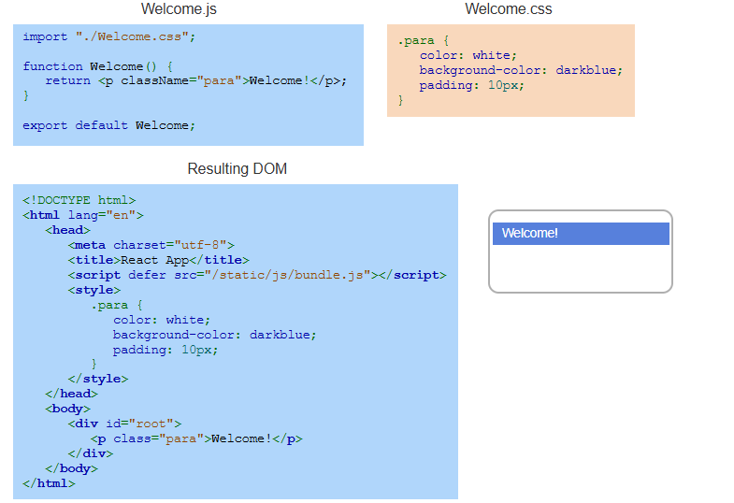
Example
Notes:
Now, let's look at an example of how CSS styles are applied in React. In Welcome.js, we import Welcome.css and assign a class name to the paragraph element. In Welcome.css, we define styles for the .para class. When React renders the component, these styles are applied in the DOM, resulting in a styled paragraph with a blue background and white text.

Slide 4
CSS Modules
CSS modules scope styles to a specific component, preventing conflicts.
The file is named ComponentName.module.css (e.g., Welcome.module.css).
Import styles using import styles from "./Welcome.module.css"; and apply them as {styles.className}.
Notes:
Building on regular stylesheets, let's explore CSS modules. CSS modules scope styles to a specific component, preventing conflicts. The file follows a naming pattern like ComponentName.module.css. To use it, import the styles and apply them with styles dot class Name. This ensures each component has its own isolated styles, avoiding unintended overrides.

Slide 5
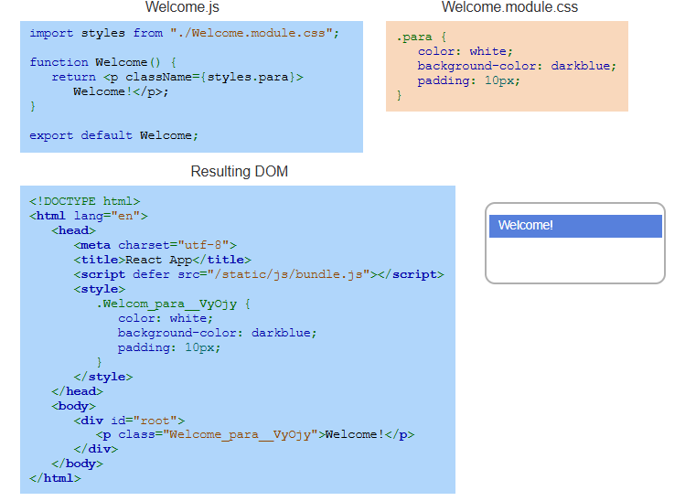
Example
Notes:
Now, let's see an example of CSS modules in action. In Welcome.js, we import styles from Welcome.module.css and apply them using styles dot para. In Welcome.module.css, we define the .para class. When React renders the component, it automatically generates a unique class name in the DOM, preventing style conflicts and ensuring scoped styling.

Slide 6
Bootstrap
Bootstrap provides pre-designed CSS classes to style React apps quickly.
Install it using npm install bootstrap and import it in the project.
Use Bootstrap classes (e.g., "btn btn-primary") to style components without custom CSS.
Notes:
Now that we have explored CSS modules, let's talk about Bootstrap. Bootstrap provides pre designed CSS classes to quickly style React apps. To use it, install Bootstrap with NPM and import it into your project. Instead of writing custom styles, you can apply Bootstrap classes like BTN BTN primary to instantly style components, making development faster and easier.

Slide 7
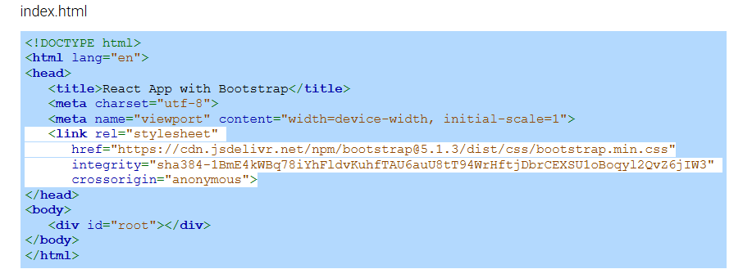
Example
Notes:
To use Bootstrap in a React app, we first include its stylesheet in index.html. Here, we add a link tag to load Bootstrap from a CDN. This makes Bootstrap styles available throughout the app, allowing us to use its pre-designed classes without writing custom CSS. Now, let's see how we can apply Bootstrap classes in a React component.

Slide 8
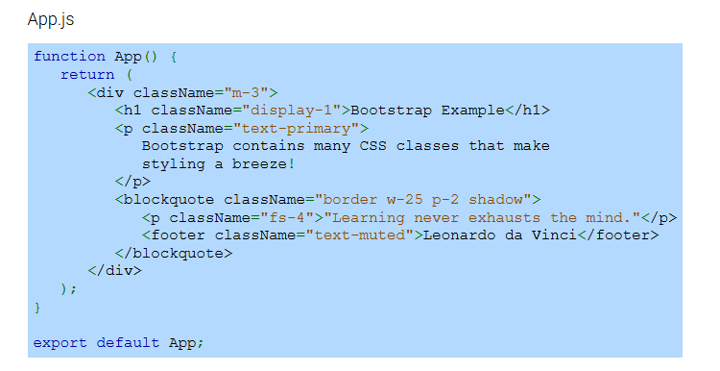
Example (Continue)
Notes:
In App dot JS, we use Bootstrap classes to style components. The m 3 class adds margin, display 1 makes the heading large, and text primary applies a blue color. We also use Bootstrap utility classes like border, shadow, and FS 4 to style the blockquote. These classes help create a visually appealing layout without writing any custom CSS. Now, let's see the output.

Slide 9
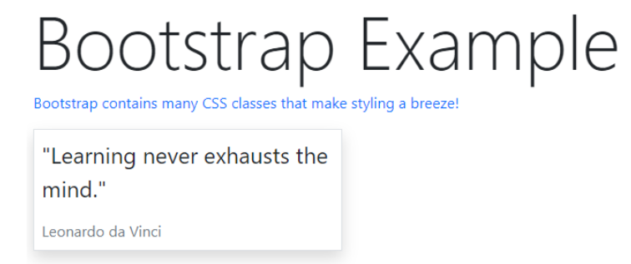
Example (Continue)
Notes:
Here is the final output. The Bootstrap styles are applied, making the heading large, the text blue, and the blockquote styled with a shadow and border. This example shows how easy it is to enhance a React app using Bootstrap's pre built classes. With just a few class names, we achieve a clean and professional look without writing custom styles.

